Slide 1
The Chomsky Hierarchy

Slide 2
Chomsky Hierarchy
Type-0 grammars
Phrase structure grammar or
(unrestricted grammars)
include all formal grammars:
  In which no restrictions are made on the left and right sides of the grammar's productions

Slide 3
Type-0 grammar (Unrestricted Grammar)
They generate exactly all languages that can be recognized by a Turing machine.
These languages are also known as the recursively enumerable languages.
This is different from the recursive languages which can be decided by an always halting Turing machine.

Slide 4
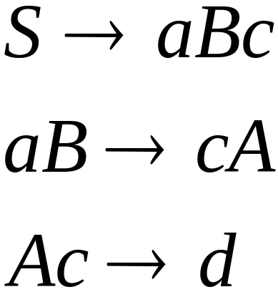
Example unrestricted grammar:

Slide 5
An Example of Unrestricted Grammars
S → ACaB
Ca → aaC
CB → DB
CB → E
aD → Da
AD → AC
aE → Ea
AE → ε
The language is
Makes it
Unrestricted Grammar
Prof. Busch - LSU

Slide 6
S → ABC
AB → aAD
AB → bAE
DC → BaC
EC → BbC
Da → aD
Db → bD
Ea → aE
Eb → bE
AB → ε
C → ε
aB → Ba
bB → Bb
Unrestricted Grammar
This grammar generates the language
L = {ww | w ∈ {a, b}∗ },
which is not context-free.
Prof. Busch - LSU

Slide 7

Theorem:
A language is Turing-Acceptable
if and only if is generated by an
unrestricted grammar

Slide 8
Chomsky Hierarchy
Type-1 grammars (context-sensitive grammars) generate the context-sensitive languages:
  In which the left-hand sides and right-hand sides of any production rules may be surrounded by a context of terminal and non terminal symbols

Slide 9

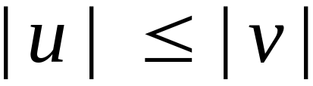
Context-Sensitive Grammars:
Productions
String of variables
and terminals
String of variables
and terminals
and:

Slide 10
Context-Sensitive Grammars:
Type-1 grammar
The rule is allowed if S does not appear on the right side of any rule.
The languages described by these grammars are exactly all languages that can be recognized by a non-deterministic Turing machine whose tape is bounded by a constant times the length of the input.

Slide 11
Example:
S → ABC
S → ABCS
AB → BA
AC → CA
BC → CB
BA → AB
CA → AC
CB → BC
A → a
B → b
C → c
Context Sensitive Grammars
L = {w ∈ {a, b, c}⁺
| #(a) = #(b) = #(c)},
which is not context-free.
Prof. Busch - LSU

Slide 12
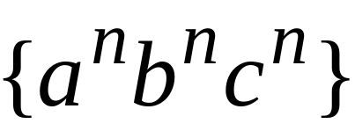
S → ASCB
S → ACB
CB → CR
CR → BR
BR → BC
AB → Ab
Ab → ab
Aa → aa
bB → bb
bC → bc
cC → cc
Context Sensitive Grammar
What is the Language?
Prof. Busch - LSU

Slide 13
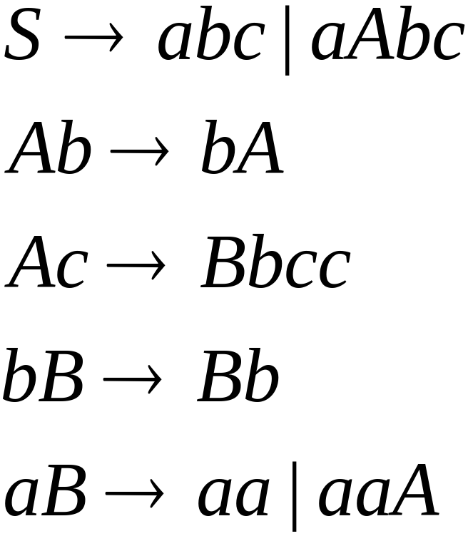
The language
is context-sensitive:

Slide 14
The chomsky hierarchy
Type-2 grammars (context-free grammars) generate the context-free languages.
Context free languages are the theoretical basis for the syntax of most programming languages.
Production rules are of the form
A→S
where A is a single non terminal and s can be terminal nonterminal or any combination
A→ Aa/a
S→AS/ab/AB/Null

Slide 15
The chomsky hierarchy
Type-3 grammars (regular grammars) generate the regular languages.
These languages are exactly all languages that can be decided by a finite state automaton. Additionally, this family of formal languages can be obtained by regular expressions.

Slide 16
The Chomsky Hierarchy
Turing-Acceptable
decidable
Context-sensitive
Context-free
Regular

Slide 17
The Chomsky hierarchy for formal languages
No TMs exist
TMs that always halt (Decider)
LBA
TMs that need not
always halt
Non-RE Languages
Context-
free
(PDA)
Regular
(DFA)
Recursively
Enumerable (RE)
Context
sensitive
Recursive
Machines are what we allow them to be!!
“Undecidable” problems
Notes:
Cpt S 317: Spring 2009
School of EECS, WSU

Slide 18
The Chomsky Hierarchy of Formal Languages
Type | Name | Restrictions on Rules | Minimal Automation / Acceptor
 |  | X → Y
0 | Phrase-structure = | X = string of nonterminals | TM
 | Recursively Enumerable (Unrestricted) | Y = any string
 | Recursive |  | TM (Decider)
1 | Context-sensitive | X = string of nonterminals | LBA (linear-bounded automaton, which is a TM with bounded tape)
 |  | Y = any string with length at least the length of X
2 | Context-free | X = one nonterminal | PDA
 |  | Y = any string
3 | Regular | X = one nonterminal | FA
 |  | Y = tN or Y = t, where t is a terminal and N is a nonterminal
Each category of languages or grammars is a proper superset of the category directly beneath it.
Prof. Busch - LSU

Slide 19
Linear-Bounded Automata:
Same as Turing Machines with one difference:
the input string tape space
is the only tape space allowed to use

Slide 20
A linear bounded automaton (LBA) is an abstract machine that would be identical to a TM, except that during a computation with given input its tape-head is not allowed to move outside a bounded region of its infinite tape, the number of accessible tape-cells being a linear function of the input-size.
The tape itself has infinite length in order to accommodate inputs of arbitrary length.
Prof. Busch - LSU

Slide 21
Like the Turing machine, an LBA is a finite state machine equipped with a tape.
Unlike a Turing machine system, an LBA system (the finite state machine plus its tape) has only finitely many system states for each input; that is, for each input, an LBA system behaves as a finite automaton.
A pertinent difference between an LBA and a FSA is that the number of states of an FSA is fixed for that FSA, while the number of states of an LBA varies as a linear function of the amount of input given to that LBA.
Prof. Busch - LSU

Slide 22
It is possible to show, using the Pumping lemma, that there are languages which are recognized by some LBA that cannot be recognized by any push-down automaton.
Linear-bounded automata recognize the class of context-sensitive languages.
Prof. Busch - LSU

Slide 23







Linear Bounded Automaton (LBA)
Input string
Working space
in tape
Left-end
marker
Right-end
marker
All computation is done between end markers

Slide 24
We define LBA’s as NonDeterministic
Open Problem:
NonDeterministic LBA’s
have same power as
Deterministic LBA’s ?

Slide 25
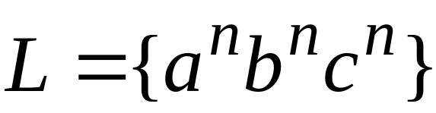
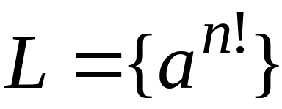
Example languages accepted by LBAs:
LBA’s have more power than PDA’s
(pushdown automata)
LBA’s have less power than Turing Machines

Slide 26
Unrestricted Grammars:
Productions
String of variables
and terminals
String of variables
and terminals

Slide 27
Properties of r.e. languages
r.e. languages are closed under
  Union,
  Concatenation,
  Closure,
  Intersection,
  Complementation and
  difference
Prof. Busch - LSU

